Slide 1
Learning through recreational research

Slide 2
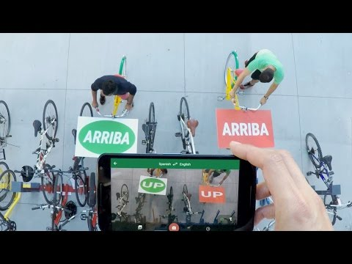
Google Translate - Word lens

Slide 3
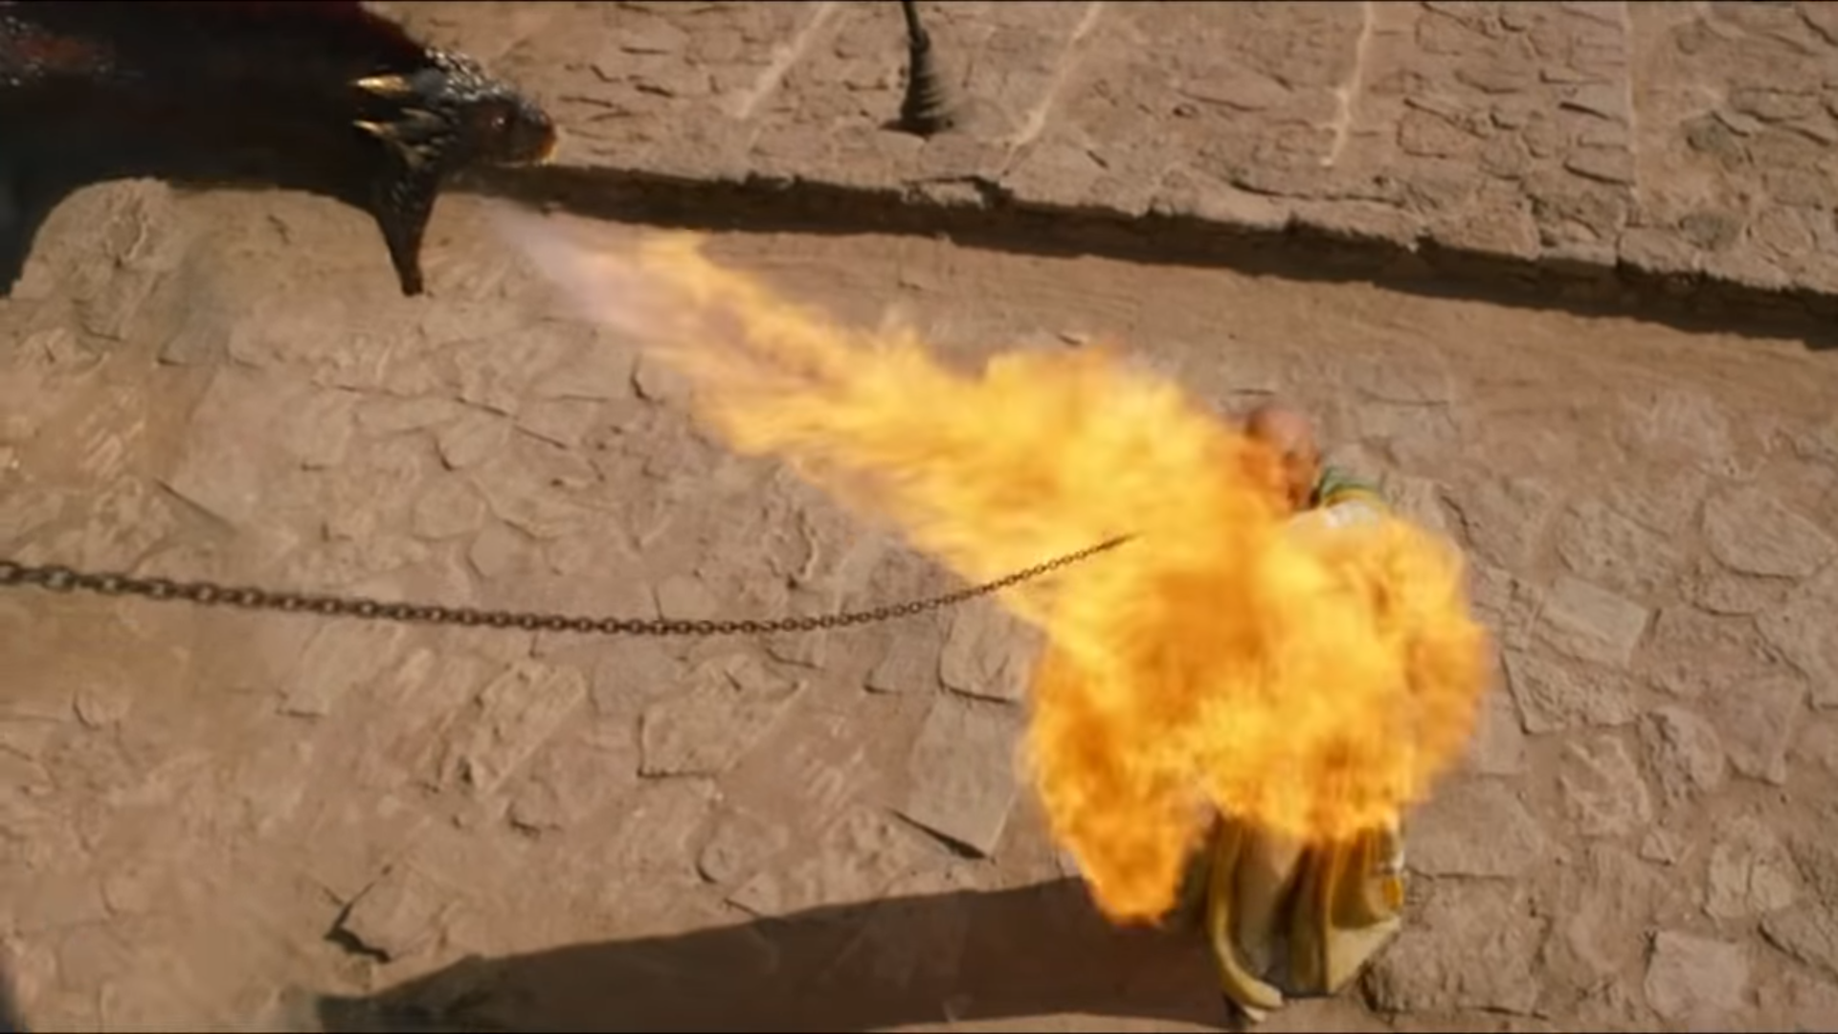
Vision helps us understand what is going on in this scene
*Im adding text to this image to make it compliant to DMCA fair use policy*

Slide 4
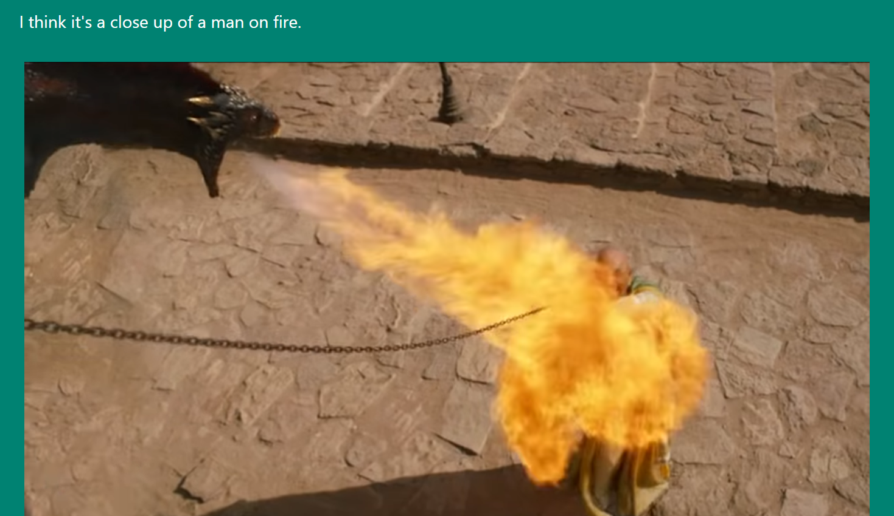
This is what CaptionBot tells us what it sees in the image

Slide 5
What are we doing here?
Talking about Computer Vision (more specifically Convnets)
Showing how Convnets work
“Seeing” how Convnets learn by recreating the landmark NIPS 2012 paper
Now what do we do?

Slide 6
The process of recreational research
Now what do we do?
Talk about Vision
This diagram because bullet points are boring
Recreating this model
Modeling vision using Convnets

Slide 7
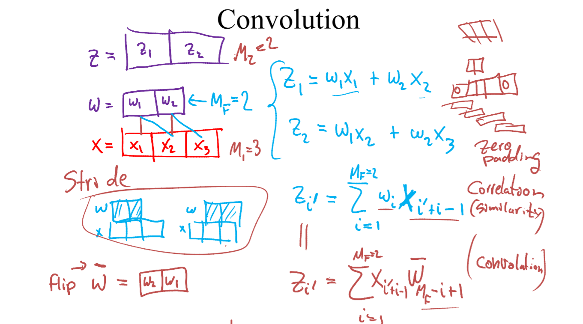
https://www.cs.ox.ac.uk/people/nando.defreitas/machinelearning/lecture9.pdf

Slide 8
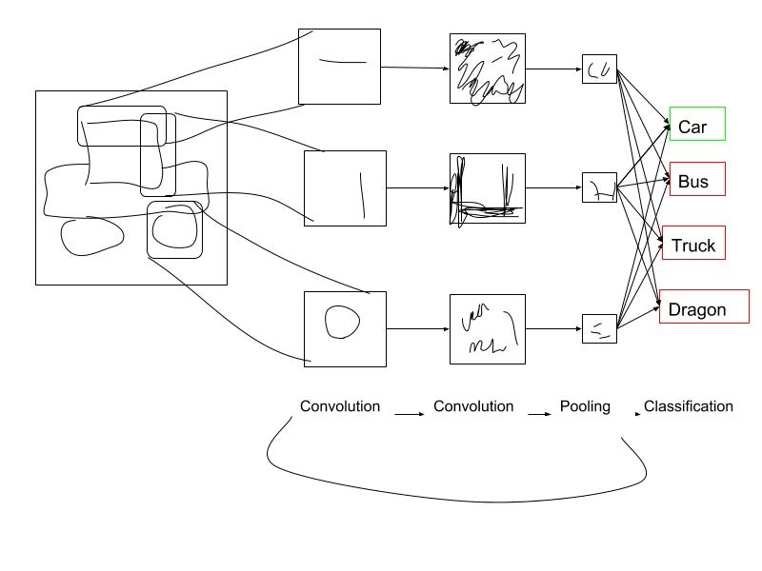

Slide 9
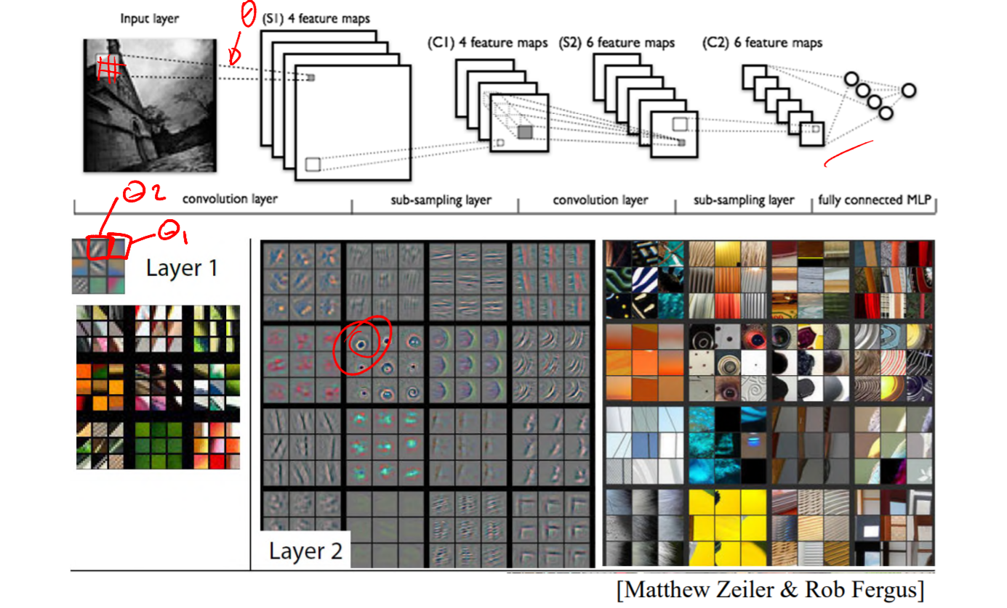

Slide 10
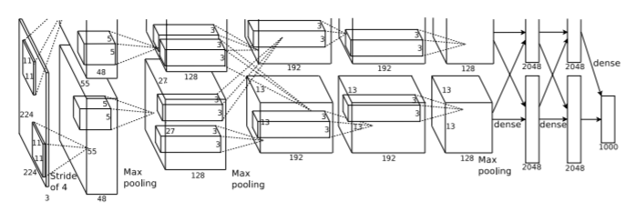
Jump to Jupyter notebook for recreating this model and jump to Section 3.5

Slide 11
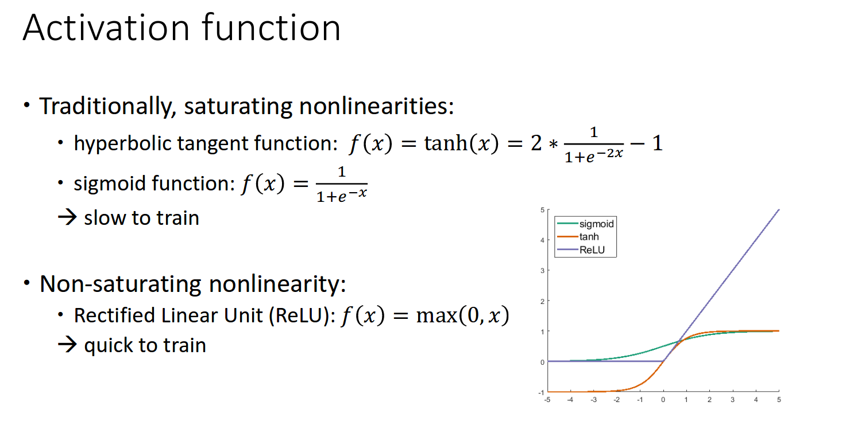
http://cvml.ist.ac.at/courses/DLWT_W17/material/AlexNet.pdf

Slide 12
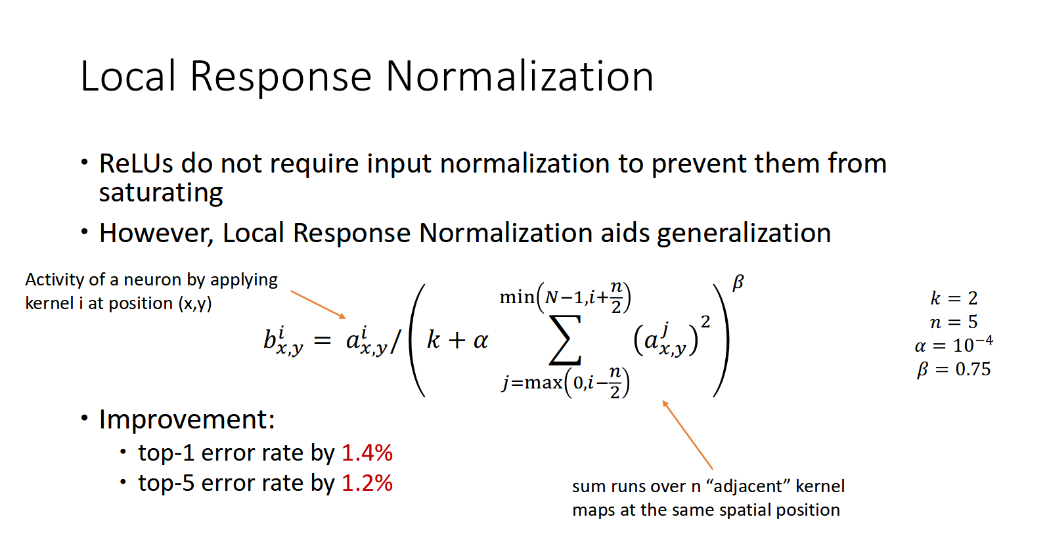
http://cvml.ist.ac.at/courses/DLWT_W17/material/AlexNet.pdf

Slide 13
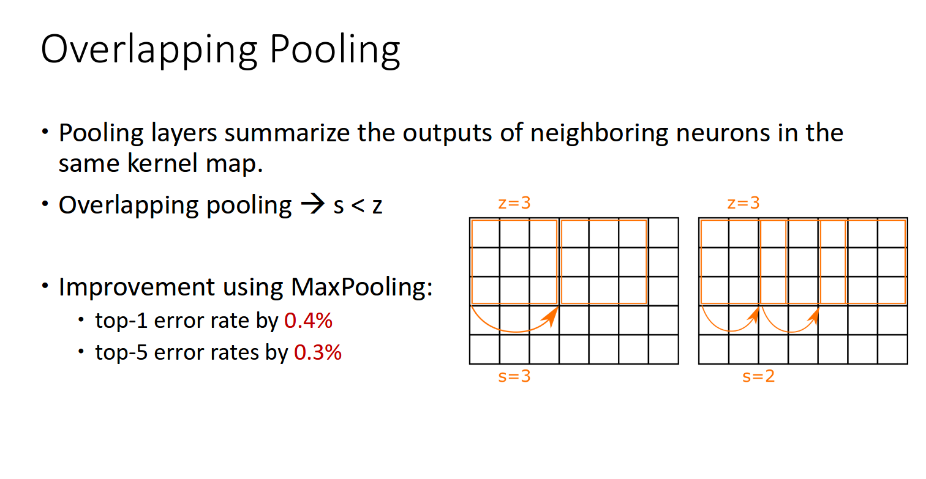
http://cvml.ist.ac.at/courses/DLWT_W17/material/AlexNet.pdf

Slide 14
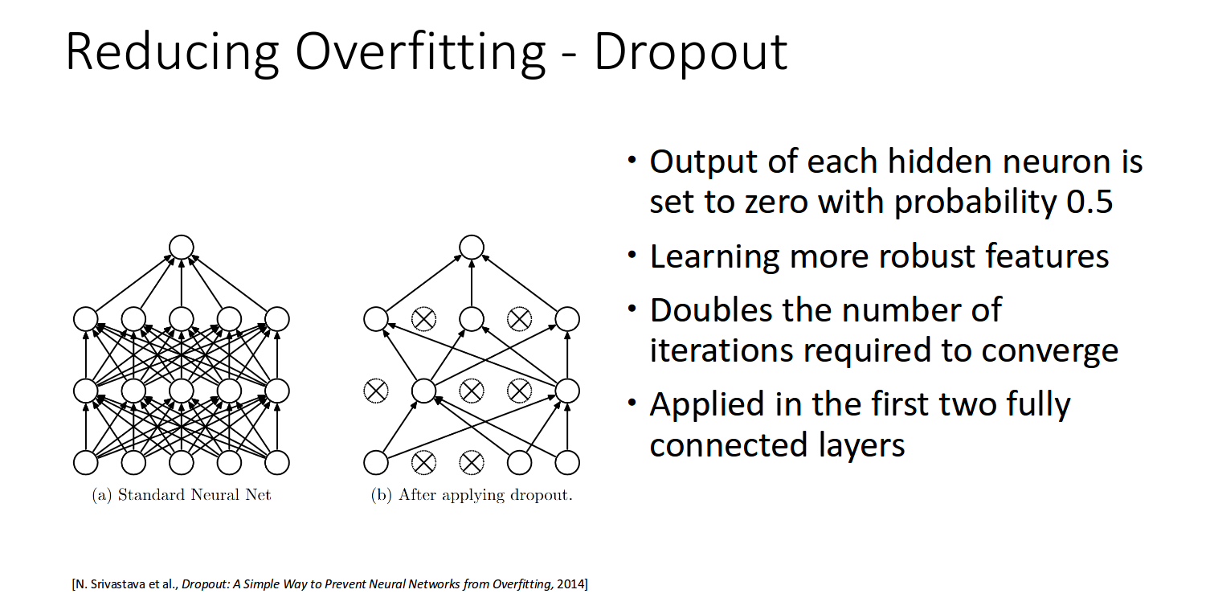

Slide 15
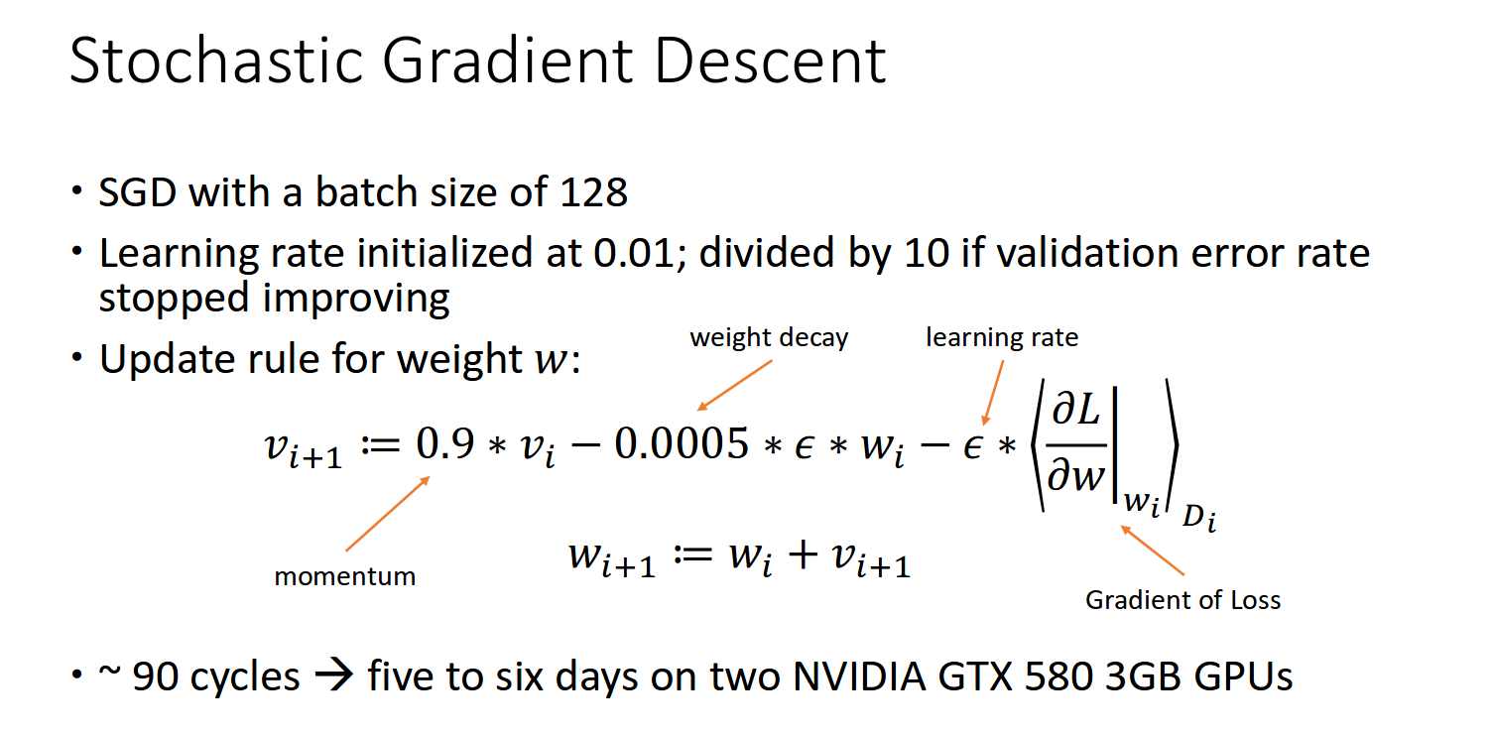
http://cvml.ist.ac.at/courses/DLWT_W17/material/AlexNet.pdf

Slide 16
“The idea he (Alex Krizhevsky) had at the time was just to re-implement the original Lenet architecture”

Slide 17
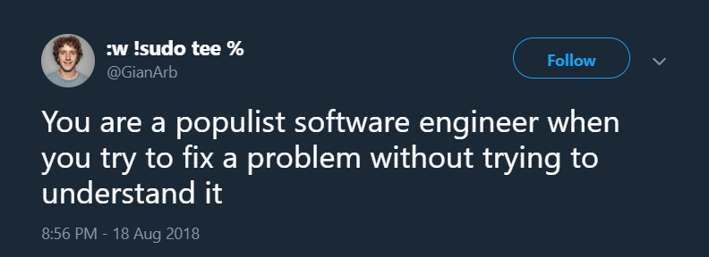

Slide 18
The process of recreational research
“Now what can we do?”
Talk about the problem
This diagram because bullet points are boring
Recreate this solution
Look for an existing but non-optimal solution

